Slide 1
Well Heating and Stirring Module Proposal
Rudy Heredia-Jantz

Slide 2
Requirements
85.5 mm x 127.75 mm footprint.
12 vial capacity, with a planned 24 vial capacity.
Must be capable of rotating magnetic stir bars within vials.
Must be able to heat samples to 100°C ± 5°C.
Independent control of wells is preferred.
Interfaces with the Science Jubilee’s Arduino microcontroller.
Programmable through a Jupyter notebook interface.

Slide 3
Stirring methods
Belt/Gear driven | Motor driven
Uniform Control 1 – 4 motors Mechanical Prone to friction, tight tolerances are required Harder to manufacture Low cost, most components can be printed/ordered at a low cost. | Individual control 12 motors Electrical Few sources of friction, much larger tolerances Easier to manufacture Medium cost, most components can be ordered online, custom circuitry required.

Slide 4
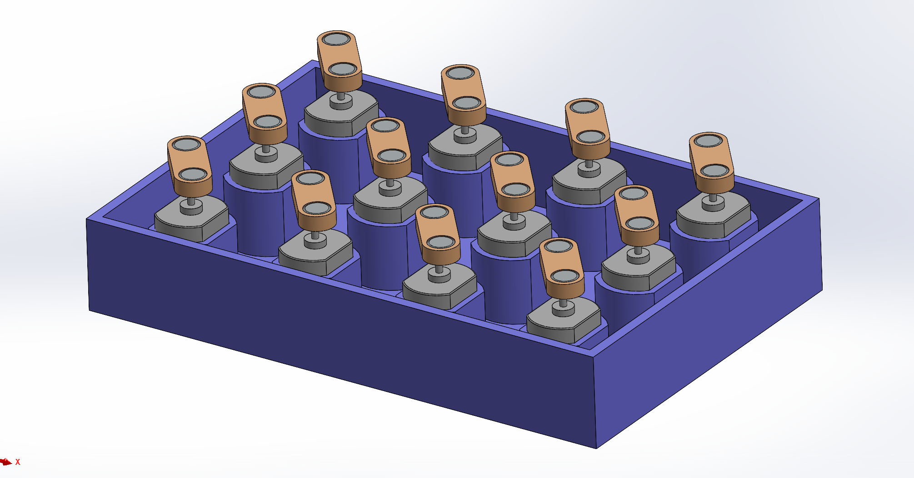
Motor Driven Stirring
3 x 4 array of 5 V DC motors.
Oppositely oriented pairs of rotating diametric magnets are used to interact with stir bars.
3D Printed housing.
All motors are wired in parallel*

Slide 5
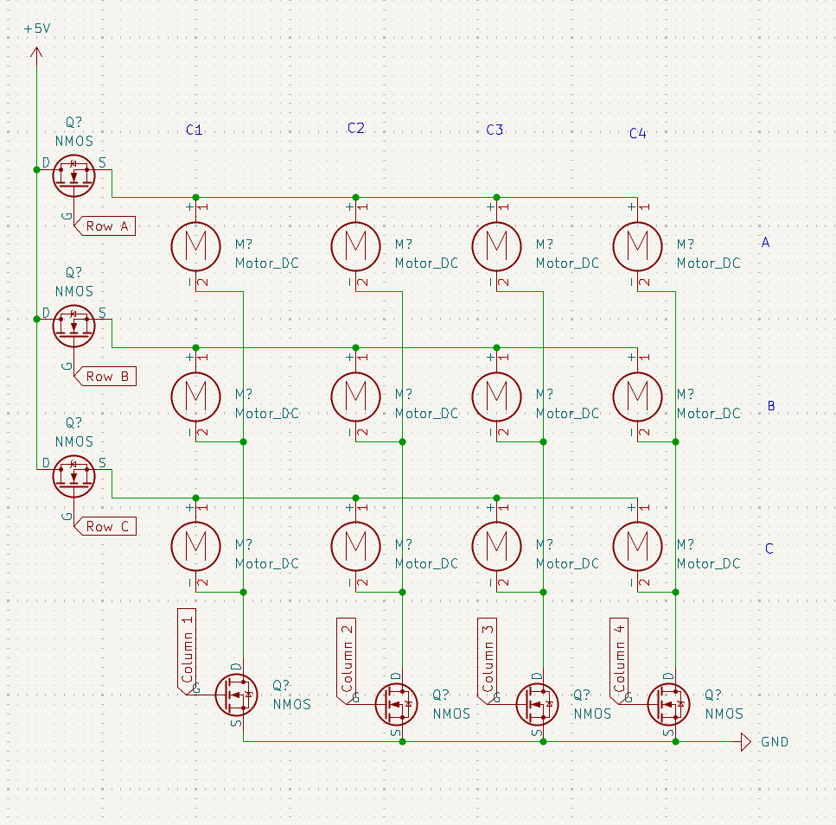
Electric Motor Control
MOSFET’s enable individual* well control.
Can be modified to only control columns/row.
Each motor draws 191 mA under load
2.29 A total draw
11.45 W power usage.
PWM (Pulse width modulation) can be utilized to control motor speed.
Each MOSFET must interface with a microcontroller or IC pin.

Slide 6
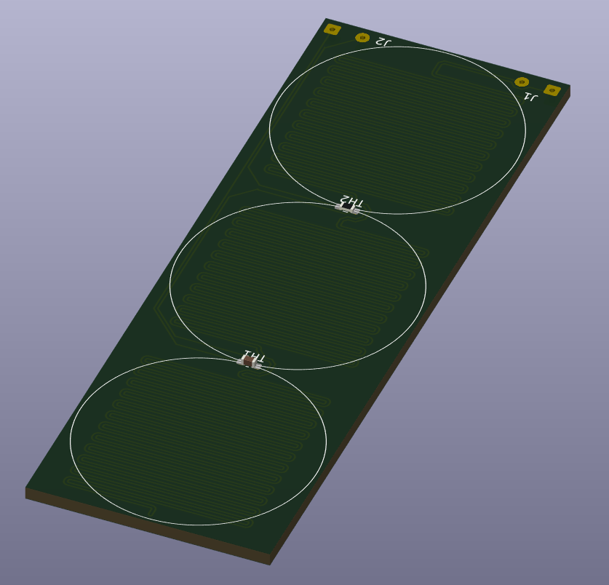
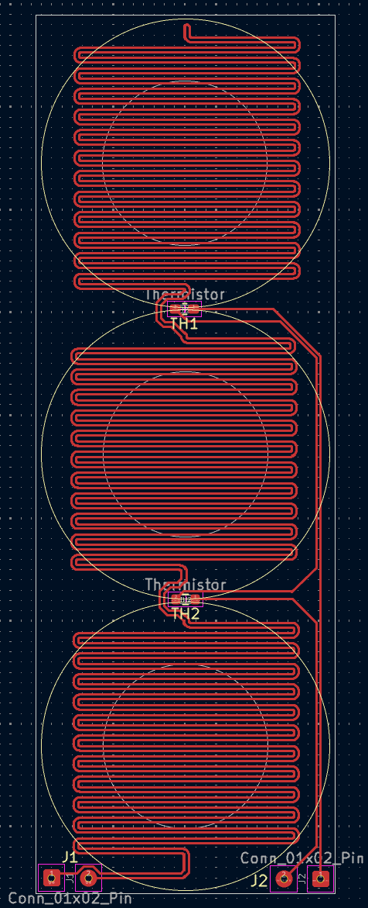
Programmable Heating
Inspired by modern 3D printer heating beds.
Custom PCB constructed on FR-4.
~$20 JLCPCB
FR4 has a glass transition temperature of 135 °C
Thermistors are used to measure the temperature of the board.
An external MOSFET controls current through the main traces. Resistance in the traces results in heat.
Individual well heating is possible but increases complexity.
Resistance of around 4 Ω, current draw of 1.25 A.
Total current draw of 5A, 25W power draw.

Slide 7
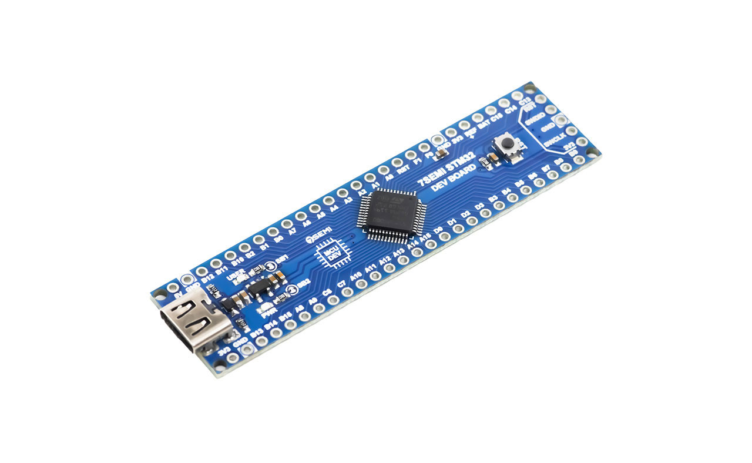
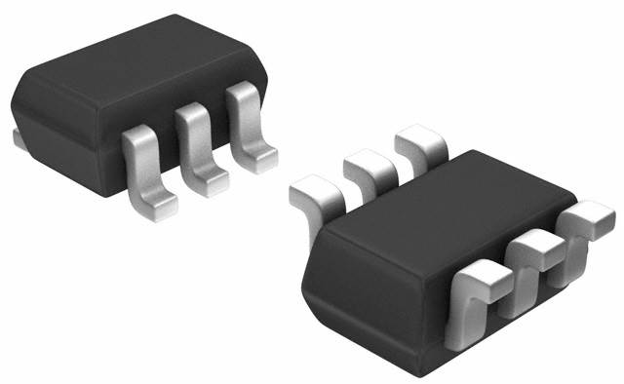
Arduino Interface
15 GPIO Pins will be required at minimum to control the module.
An additional microcontroller can be used to minimize clutter / egregious wiring.
Communicates with Arduino via UART protocol.
Integrated circuits, such as Multiplexers, can be used instead, although they increase design complexity.

Slide 8
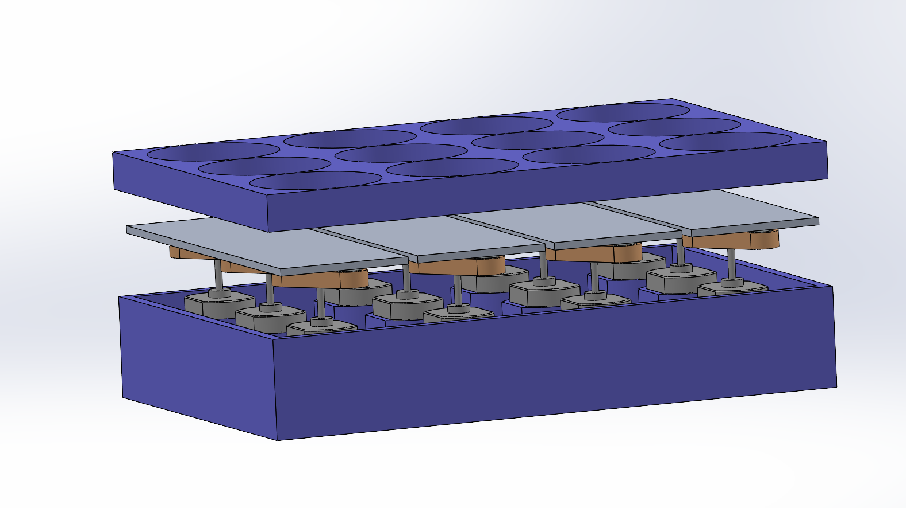
Planned Assembly
Standoffs separate motor housing, heating pads, and vial wells. Isolating heat to the pads.
Printed out of a filament able to withstand ~100 °C, HTPLA or PC.
The heating pads do not interfere with the magnets due to the properties of FR-4.
Can be scaled down to accommodate 24 vials.

Slide 9
Roadmap
Research and design.
Motor housing .
Power distribution.
Microcontroller interface and circuitry.
Component selection.
Testing/Verification
Breadboarding, motor and heating circuitry.
PWM control.
Component ordering.
Motor housing.
Programming
Microcontroller interface.
UART communication.
Python integration.
Assembly
Custom PCB’s for motor and heating circuitry?
Mounting on Jubilee.
Soldering components.
Documentation
Operating manual.
Schematics.
Training.

